Slide 1
Welcome to DevOpsDC!
6:30 - 7:00: Meet, greet, and eat!
7:00 - 7:15: Intros and Announcements
7:15 - 8:45: Presentations
DevOps Design Patterns
Orchestrating VMware
8:45 - 9:00: Networking

Slide 2



Sponsors
Notes:
Let’s hear from our sponsors

Slide 3
Code of Conduct
http://www.meetup.com/DevOpsDC/pages/Code_of_Conduct/
We value the participation of each member of the community and want all attendees to have an enjoyable and fulfilling experience. Accordingly, all attendees are expected to show respect and courtesy to other attendees throughout all Meetup events.
To make clear what is expected, all delegates/attendees, speakers, exhibitors, organizers, and volunteers at any DevOpsDC event are required to conform to our Code of Conduct. Organizers will enforce this code throughout events.
Notes:
Conduct matters, so I’ll give you short, short version:
harassment-free experience for everyone, regardless of who you are
professional audience including people of many different backgrounds
Be kind to others. No smack talk

Slide 4
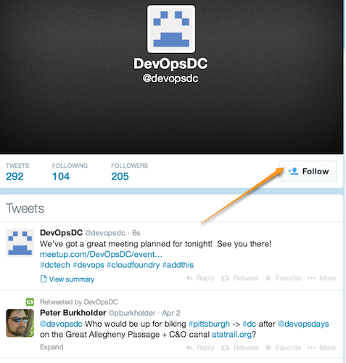
Do you even tweet?
https://twitter.com/devopsdc
Notes:
Twitter properly used is a boon

Slide 5

Slackin'…
http://www.dctechslack.com
Notes:
Now let’s talk about some upcoming events….

Slide 6
Childcare
Contact Peter….
Notes:
Now let’s talk about some upcoming events….

Slide 7

DevOpsDays

Slide 8
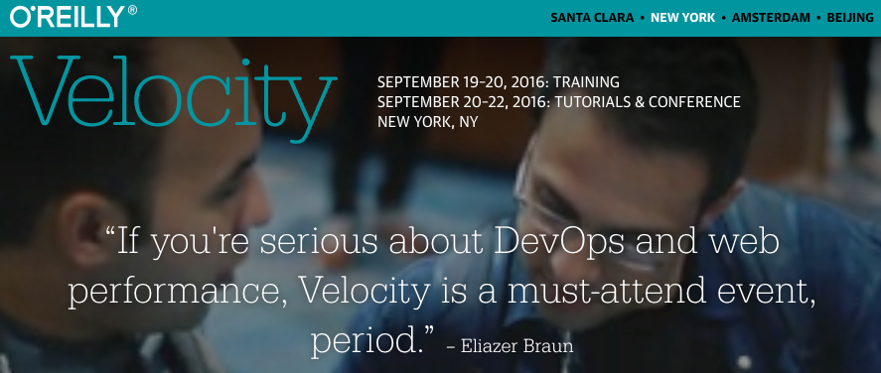

Slide 9
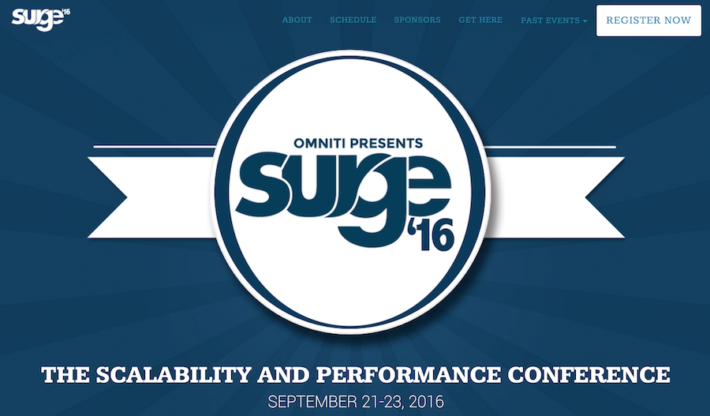
20% off with DevOpsDC16
Free One-day Workshop: Introduction to Application Automation with Habitat
https://surge.omniti.com/2016
Notes:
Ticket Price - $750
Disaster Rubber-necking

Slide 10
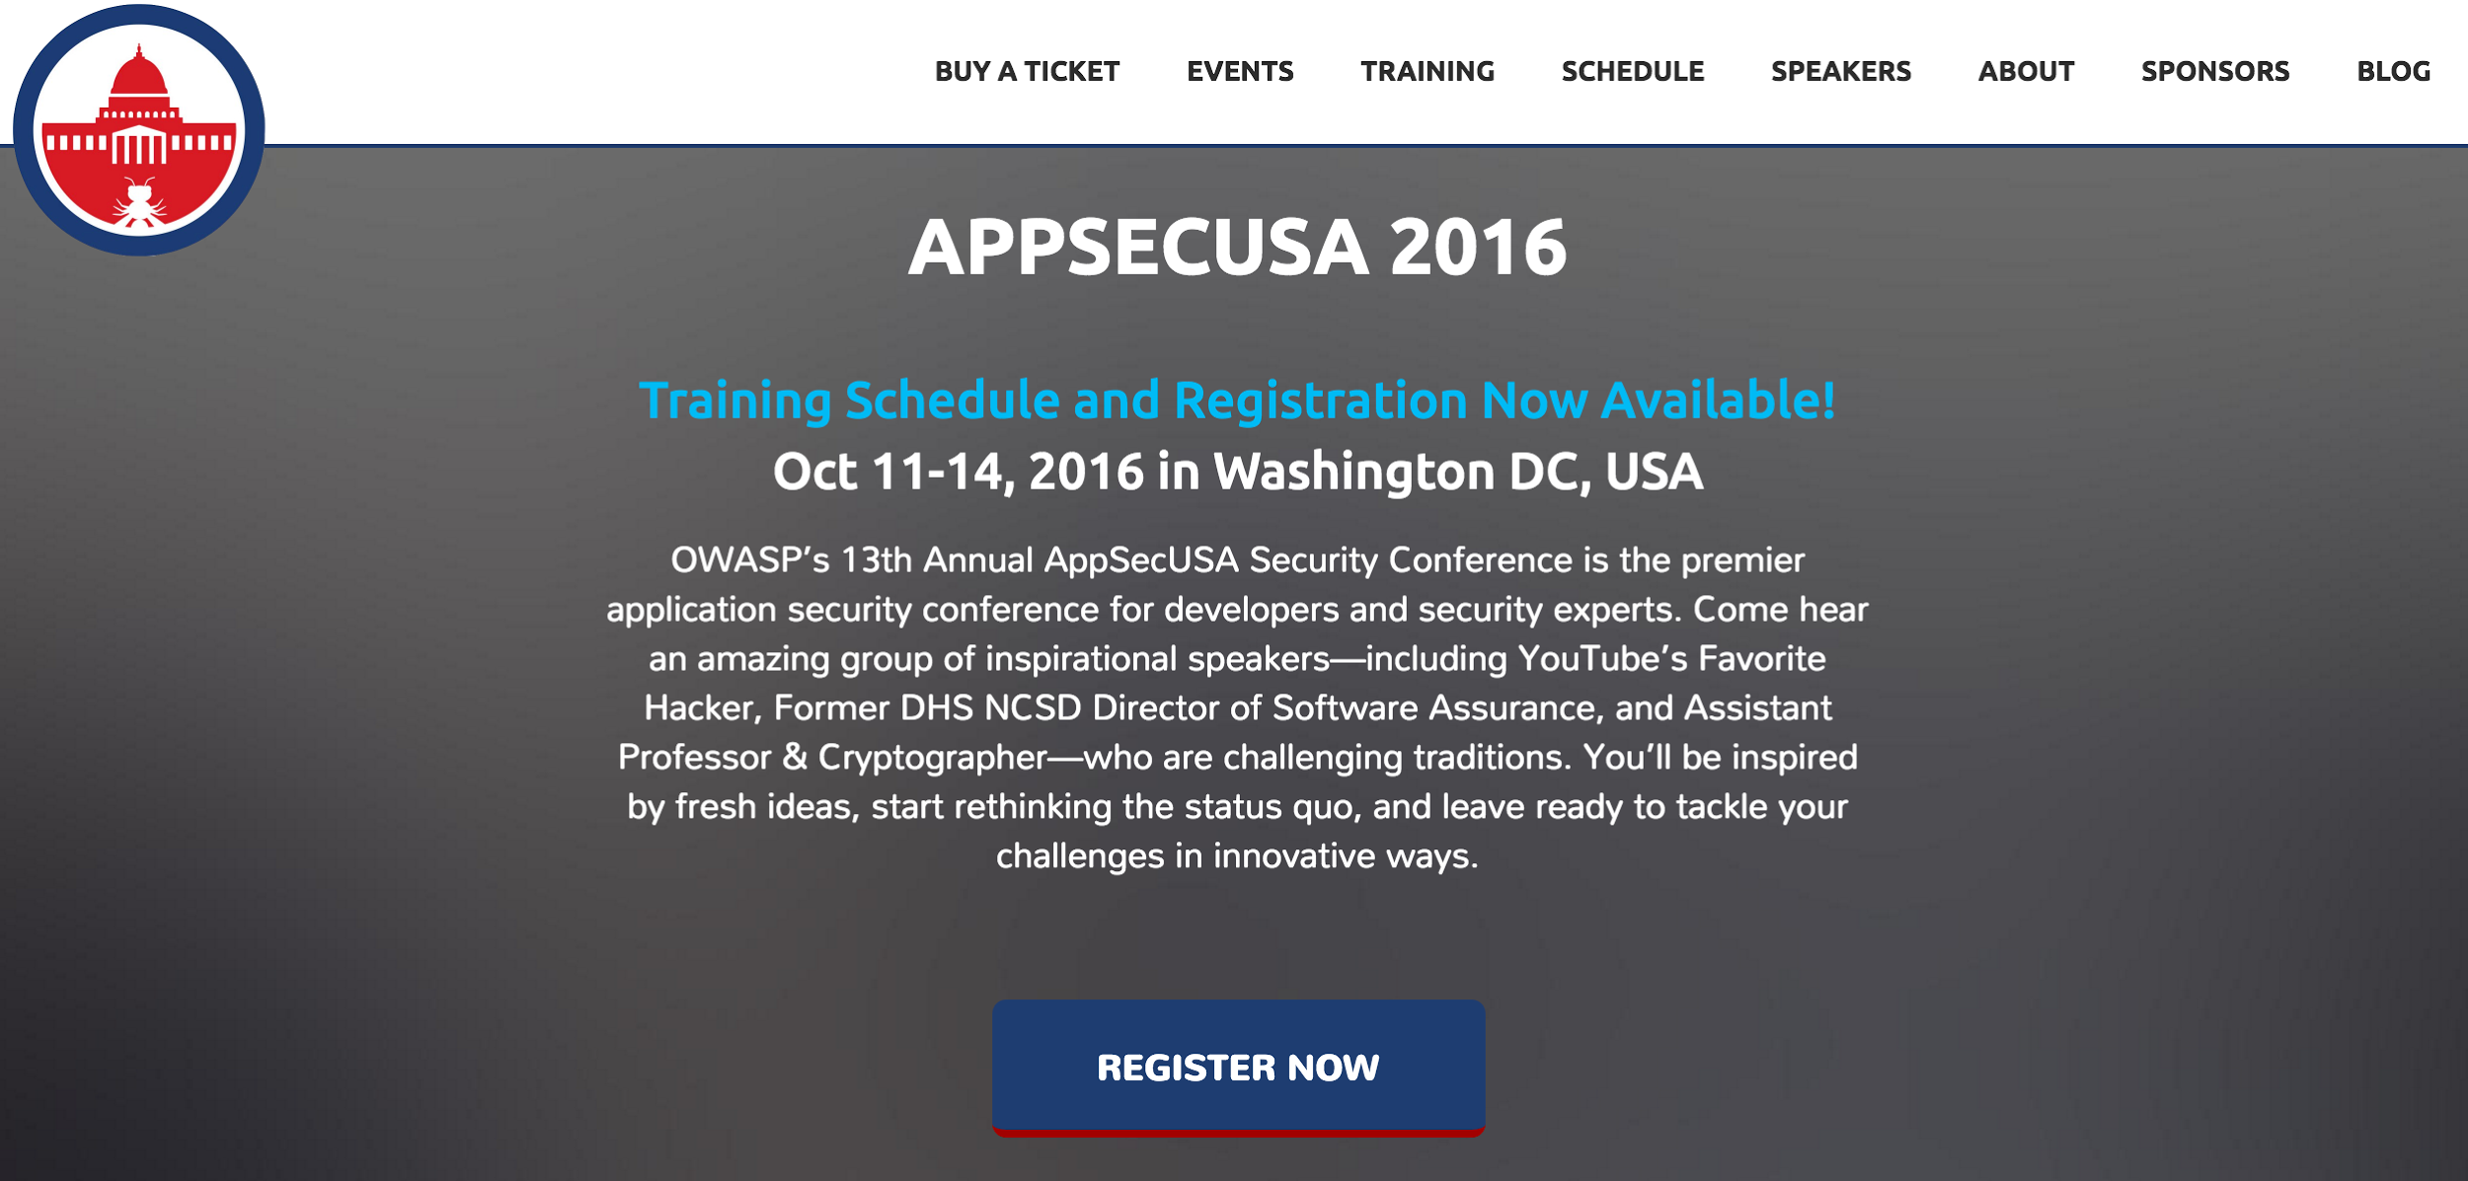
Notes:
https://2016.appsecusa.org/

Slide 11
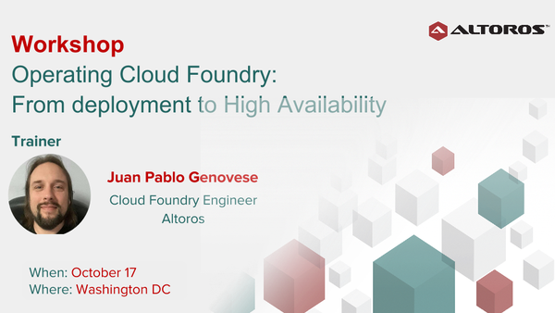
http://cf_training_dc.eventbrite.com

Slide 12


Slide 13


Slide 14
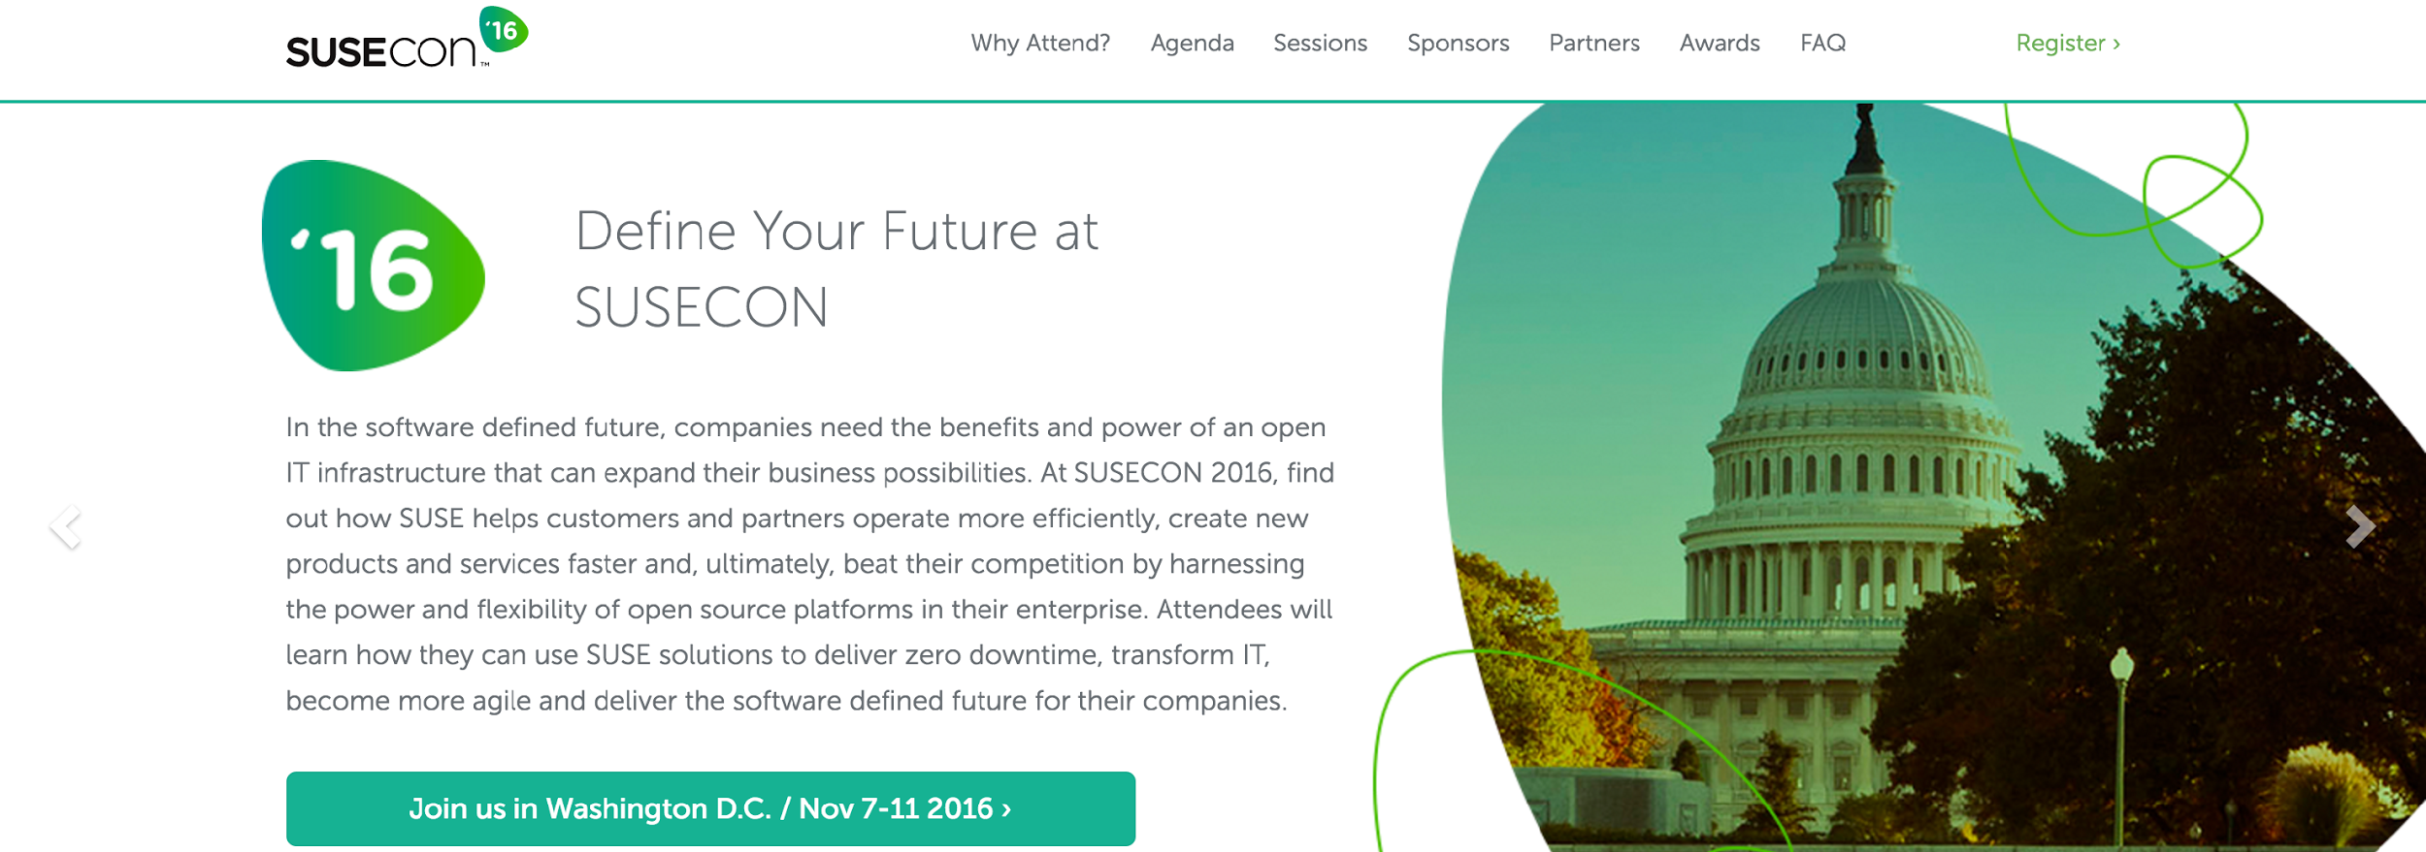
Notes:
http://www.susecon.com/

Slide 15

DevOpsDays Baltimore
March 7 & 8, 2017
http://www.devopsdays.org/events/2017-baltimore/welcome/

Slide 16
More Conferences
DevOpsDays
NYC – 23-24 Sept
Raleigh – 6-7 Oct
Philly – 26-27 Oct
Container Days NYC – 3-4 Nov

Slide 17
Upcoming Meetups
October 11 - Optoro, Analytics for DevOps & Something to do with security
November 8 - Excella Consulting, Tony Alletag & DevOps Improv
December 13 - Excella Consulting, Mark Cornick & Valiant Solutions
Notes:
September: Laura and Performance Testing in your Pipeline
October: AppSec USA is in town, our meetup will be walking distance from the conference.
Seeking one other presenter for September, November, and December

Slide 18
Now it's your turn…
Hiring?
Looking for work?
Attending or speaking at a conference?
Something we all should know?
Favorite color?
Notes:
DoL Wage & Hour division: Senior Transformation Specialist, Product Manager, Software Engineer, and User Experience Designer
Last year, we put more than $246 million into the pockets of more than 240,000 workers who had been deprived of their hard-earned wages.
‣ For German Gomez, it meant finally being able to start a family after he received more than $42,000 in unpaid wages and damages following an investigation that disclosed he had been working 72 hours a week
‣ For Raquel Bruno, it meant being able to finish her degree and help her kids go to school,after the restaurant she worked for was found to owe more than $1 million to its workers.

